Slide 1
Smart restaurant
SADJAD ALIKHANI
DEC 2018

Slide 2
Brief view
1- Registration
2- Detection
3- Wi-Fi
4- Processing
5- SMS
6- Website
7- Database
8- Behind The Scene

Slide 3

Customers register their information just once for ever.
At the end customers receive their unique tag.
Customers now have IDs.

Slide 4
Detection beginning of a journey through waves
At the entry door customers use their tag to announce their presence.
Holding the specified tag in front of the RFID Reader
RFID Reader instantly sends the tag ID to Wi-Fi Module ESP-12F

Slide 5
Wi-Fi how to send the tag id to the server ?
Wi-Fi Module as a Publisher sends the Tag ID to the MQTT Broker
Raspberry pi as a Subscriber subscribes to the specified topic
Raspberry pi receives the IDs instantly

Slide 6
Data processing what to do with received tag id ?
Raspberry pi looks for the received ID’s phone number in database
Raspberry pi generates a random hashed code and saves it in a database
The phone number and hashed code are sent to GSM Module

Slide 7
SMS Security and Website id
The hashed code is sent to the determined phone number
As soon as customers are detected through RFID Detection , they receive a SMS
The SMS contains the hashed code generated in the server
The code is their passcode and ID in website from now on
This step has been added the to the process for more security
So each time coming to Restaurant , new website ID for anything to do there
The code expires each time

Slide 8
Website what to do in the local website ?
Customers choose a table and sit on there
Connect to the Restaurant Wi-Fi
Enter the restaurant Website
Enter the ID received in SMS
Select food
Select drink
Select the chosen table
Background tables Lights Can be whether turned on or off
Lights color also can be changed to the favorite color
Just click on Submit and see the changes and wait for your food

Slide 9
Database how to save orders ?
Customers are waiting for their orders such as food and drink
As soon as they click on submit button all the information come to server and cook
Website ID , Time , Food , Drink , Table , Light State
Chef and Cooks see new orders in database whenever a buzzer beeps
MYSQL has been chosen as the database

Slide 10
Behind the scenes which programming languages have been used ?
C++
Python
SQL
HTML
PHP
CSS

Slide 11
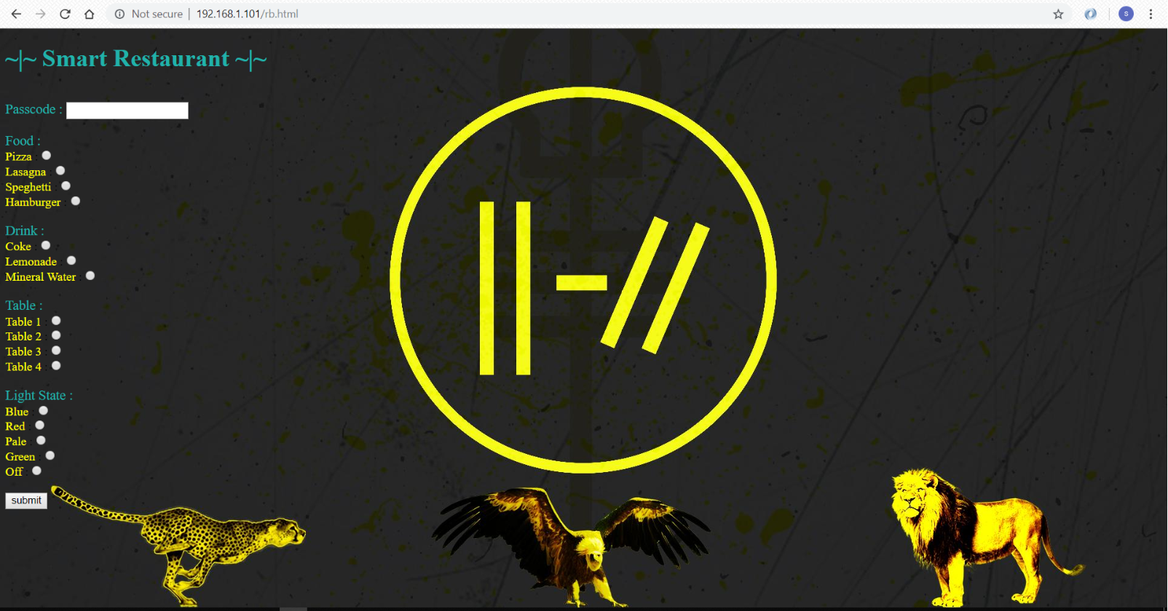
Website preview

Slide 12
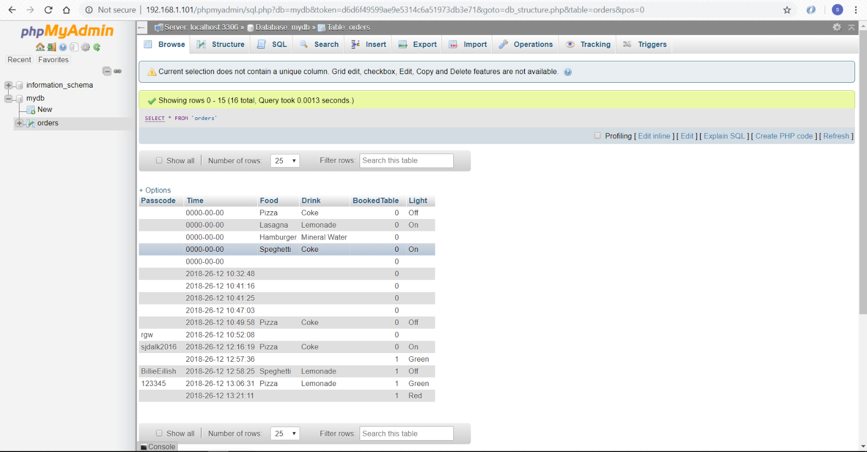
Database preview

Slide 13
The end saDjad alikhani winter 2018

